Slide 1




Chapter 41 Wave Optics (波动光学) (1)
Interference(干涉)
Notes:
1

Slide 2
41-1 Introduction
Geometrical Optics: λ<<d
Wave Optics: λ≈d
Interference, Diffraction (干涉，衍射):
all kinds of wave (Sound wave, water wave, light wave ……)
The same mathematics (相同的数学).

Slide 3

Interference for Sound …
For example, a pair of speakers, driven in phase, producing a tone of a single f and λ:
hmmm… I’m just far enough away that l₂-l₁=λ/2, and I hear no sound at all!
l₁
l₂
But this won’t work for light--can’t get coherent sources

Slide 4
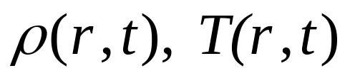
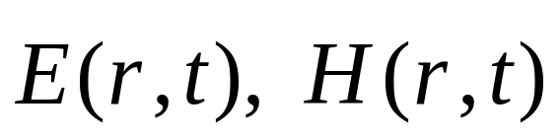
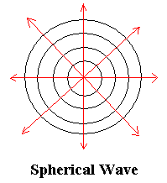
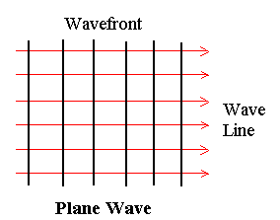
41-2 Steady Light Wave
(定态光波)
Wave: Space-Time periodicity (r, t)
Scalar Wave:
Vector Wave: EM Wave
Wave Plane (波面)
Wave ray (波线)
Spherical plane waves (球面波)
Plane Waves (平面波)

Slide 5
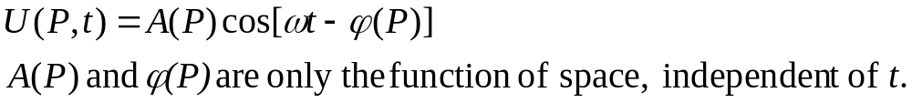
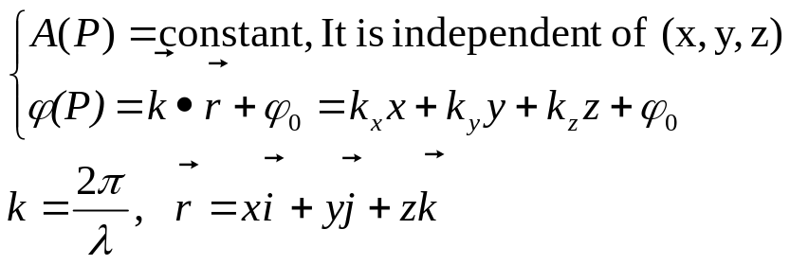
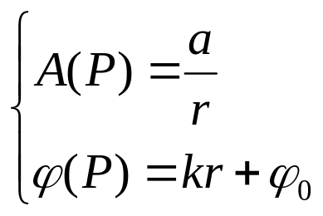
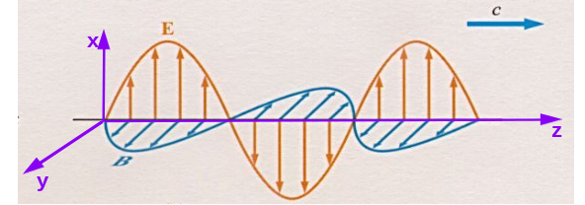
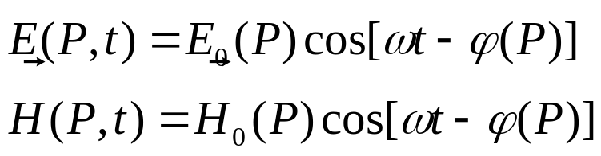
2. Steady Wave (定态波)
Steady Scalar Wave
For example:
Steady Plane Wave:
(定态平面波)
Steady Spherical Wave:
(定态球面波)
Light Wave (EM Wave)

Slide 6
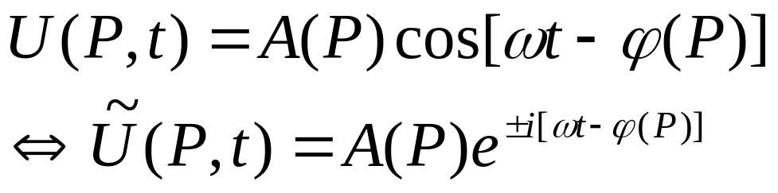
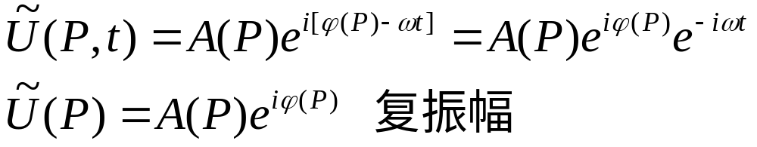
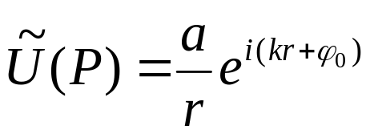
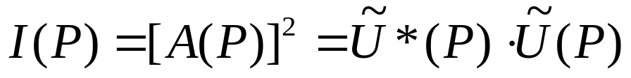
3. Complex Number Description (复数描述)
To Choose “-”
Plane Wave:
Spherical Wave:
Wave Intensity:

Slide 7
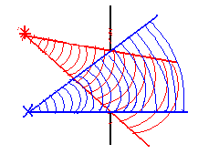
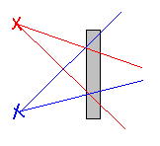
41-3 Wave Superposition and Interference
(波的叠加和干涉)
Wave superposition principle (波的叠加原理)
线性叠加
Scalar wave:
Vector wave:

Slide 8
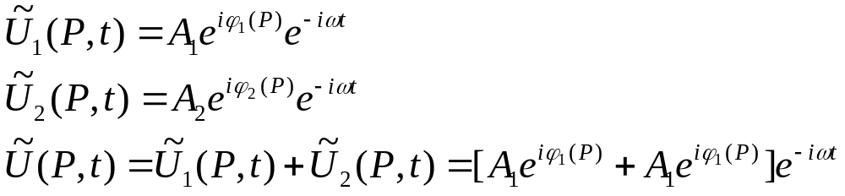
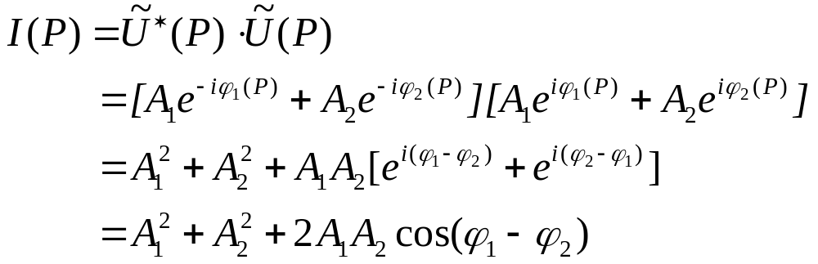
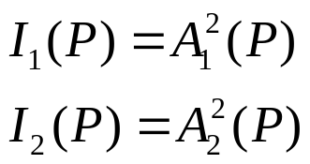
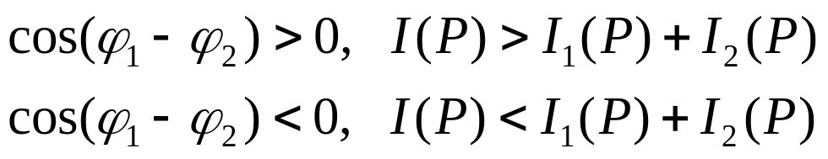

2. Wave interference and the condition of interference
(波的干涉和相干条件)
Intensity:
If:
In general:
The wave superposition results in the re-distribution of intensity in space. Wave Interference.

Slide 9
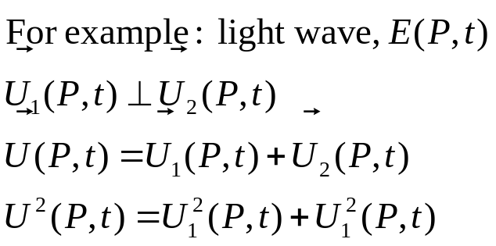
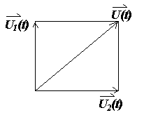
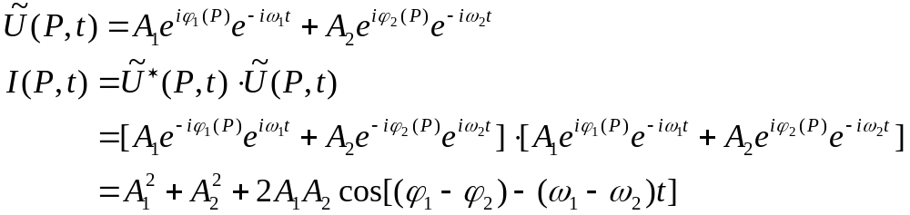
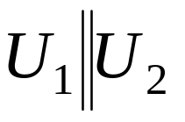
Discussion
If δ(P)=ϕ₁-ϕ₂ is not steady, cos δ(P)=cos(ϕ₁-ϕ₂ )=0
No Interference
For Vector Wave,
No interference
If ω₁≠ω₂
ω₁-ω₂≠0 cos[(ϕ₁-ϕ₂ )-(ω₁-ω₂)t]=0
I(P)=I₁(P)+I₂(P) No interference.
Interference Requirements
ω₁=ω₂= ω
ϕ₁(P)-ϕ₂(P) steady

Slide 10

Superposition
Constructive Interference
+1
t
-1
+
+1
In Phase
t
-1
+2
t
-2

Slide 11
Superposition
Destructive Interference
+1
t
-1
+
+1
Out of Phase
180 degrees
t
-1
+2
t
-2

Slide 12
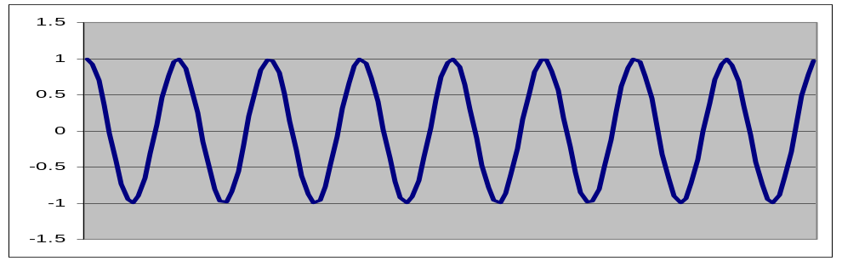
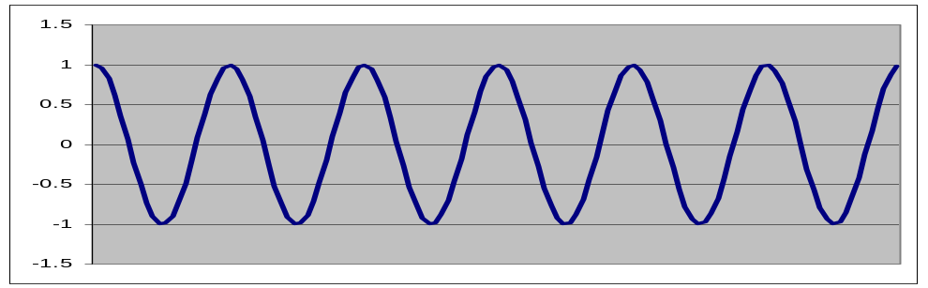
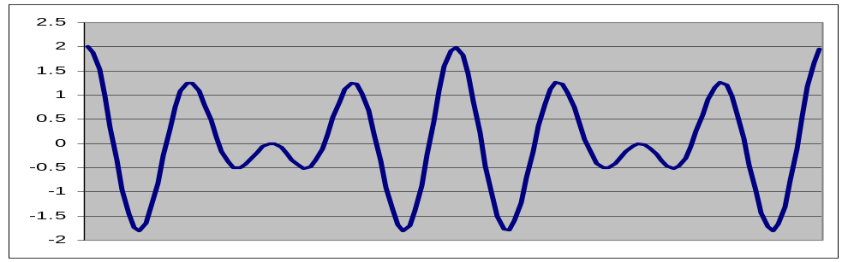
Superposition ACT
+
Different ω
1) Constructive 2) Destructive 3) Neither

Slide 13
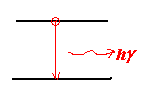



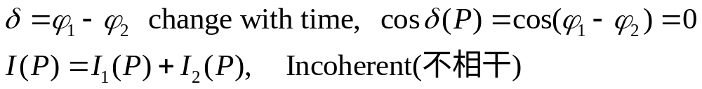
3. Coherence (相关性, 相干性)
The phase difference at points in space must not change with time.
Wave train (波列)
Laser(激光)!

Slide 14
Interference for Light …
Can’t produce coherent light from separate sources. (f ≈ 10¹⁴ Hz)
Need two waves from single source taking two different paths
  Two slits
  Reflection (thin films)
  Diffraction*
Two different paths
Interference possible here
Single source

Slide 15
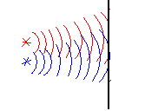
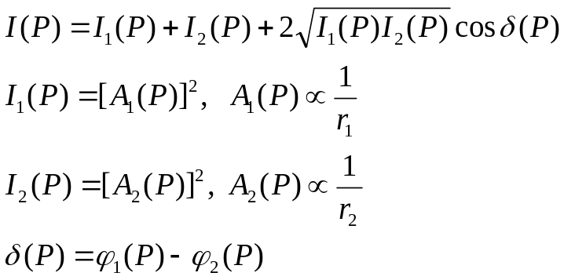
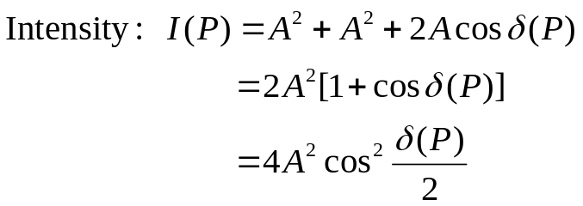
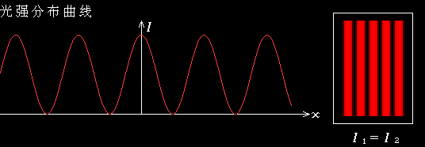




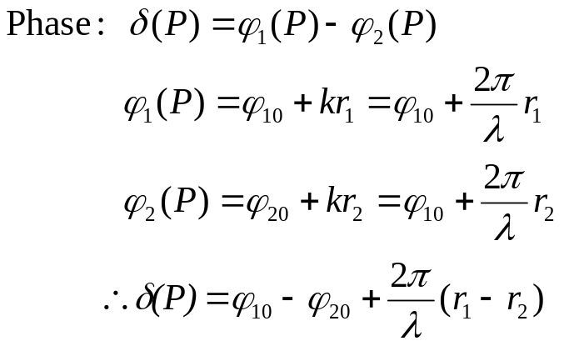
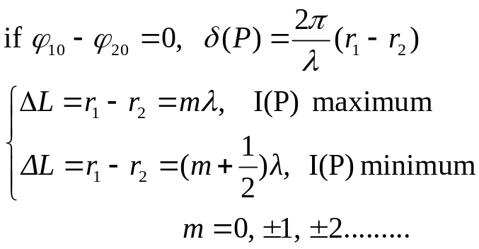
41-4 The interference of two waves
The interference of two spherical plane waves:

Slide 16
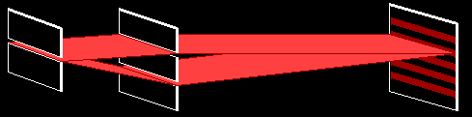
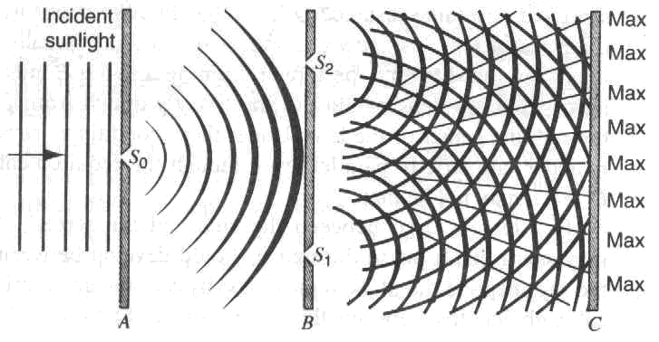
2. Young’s Double Slit Interference
（杨氏双缝干涉）

Slide 17
Young’s Double Slit Key Idea
L
Two rays travel almost exactly the same distance. (screen must be very far away: L >> a)
Bottom ray travels a little further.
Key for interference is this small extra distance.

Slide 18


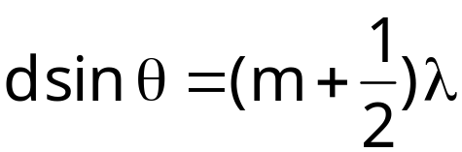
Young’s Double Slit Quantitative
d
d
d sin θ
Path length difference =
Constructive interference
Destructive interference
where m = 0, or 1, or 2, ...
Need λ < d

Slide 19
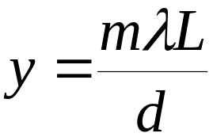
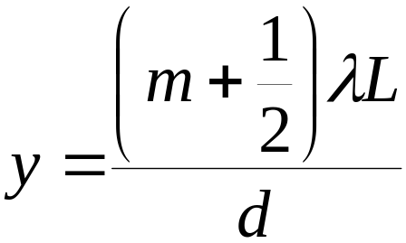
Young’s Double Slit Quantitative
L
y
d
A little geometry…
sin(θ) ≈ tan(θ) = y/L
Constructive interference
Destructive interference
where m = 0, or 1, or 2, ...

Slide 20
Preflight
L
y
d
When this Young’s double slit experiment is placed under water. The separation y between minima and maxima
1) increases 2) same 3) decreases
27% 21% 52%
Under water λ decreases so y decreases

Slide 21
Note
In the Young double slit experiment, is it possible to see interference maxima when the distance between slits is smaller than the wavelength of light?
1) Yes 2) No
Need: d sin θ = m λ
=> sin θ = m λ / d
If λ > d then λ / d > 1
so sin θ > 1
Not possible!

Slide 22
41-5 Thin Film Interference
1
2
n₀=1.0 (air)
t
n₁ (thin film)
n₂
Get two waves by reflection off of two different interfaces.
Ray 2 travels approximately 2t further than ray 1.

Slide 23
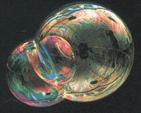
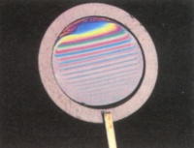
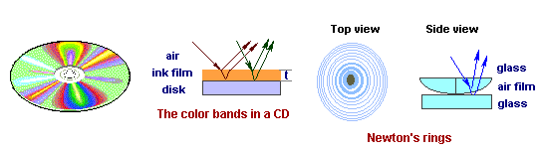
Thin Film Interference

Slide 24
Reflection + Phase Shifts
Incident wave
Reflected wave
n₁
n₂
Upon reflection from a boundary between two transparent materials, the phase of the reflected light may change.
If n₁ > n₂ - no phase change upon reflection.
If n₁ < n₂ - phase change of 180º upon reflection. (equivalent to the wave shifting by λ/2.) 半波损失

Slide 25
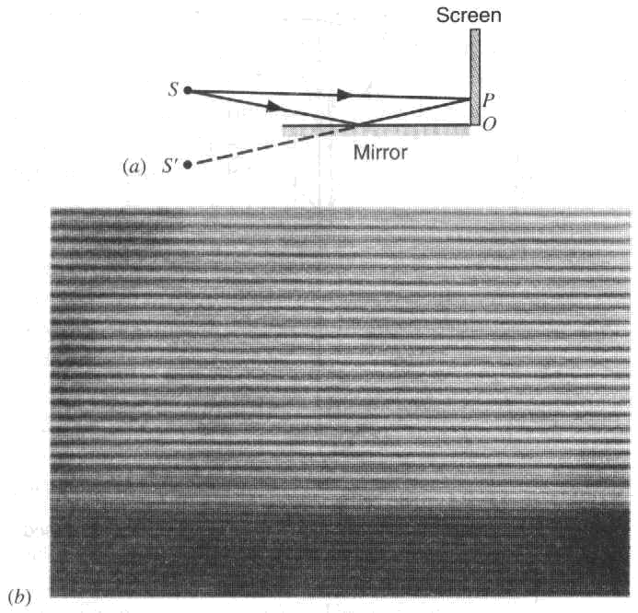
 Optical reversibility and phase changes on reflection

Slide 26
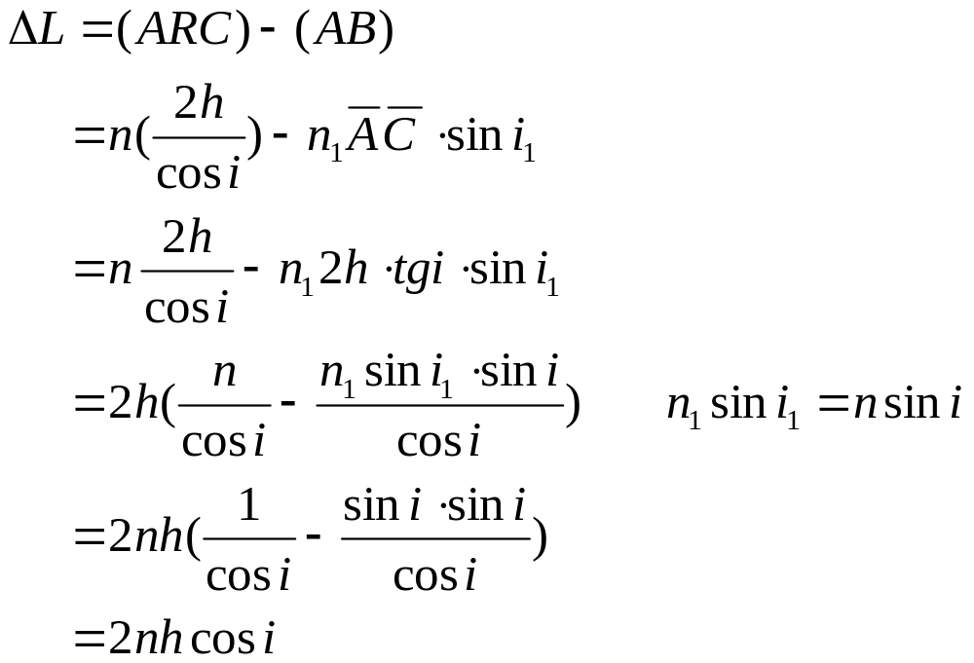
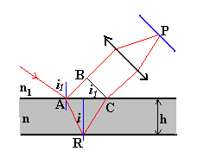
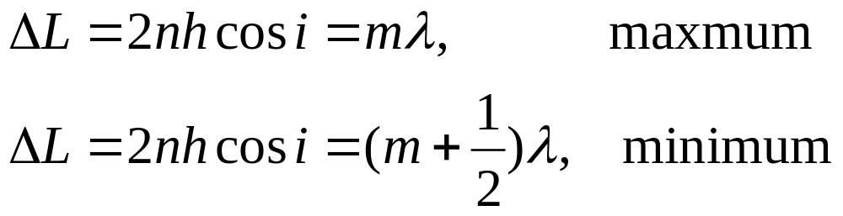
1. The thickness is the same at every point(等倾干涉条纹)

Slide 27
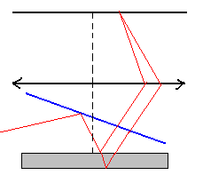
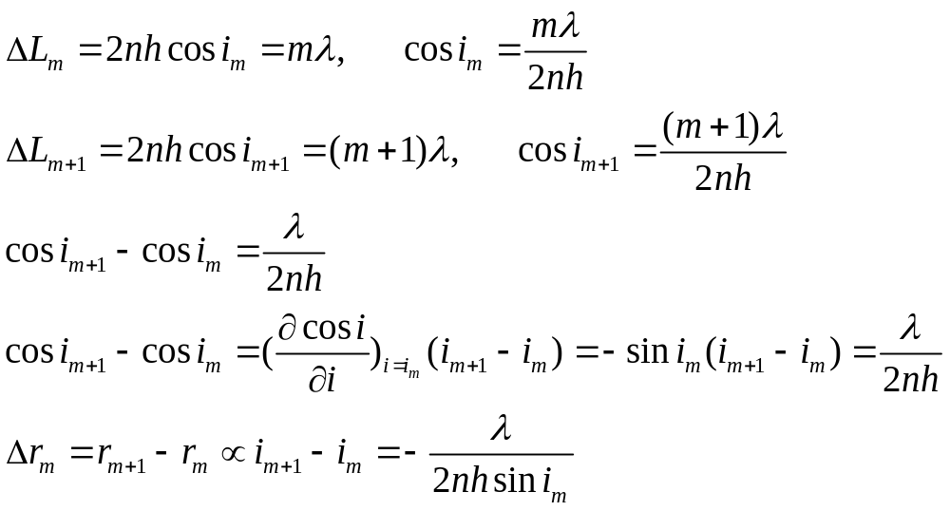
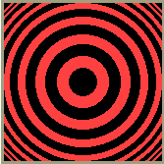
Discussion
“-”, r_{m+1}<r_{m}
n is bigger, Δr=r_{m+1}-r_{m} is smaller
h is bigger, Δr=r_{m+1}-r_{m} is smaller

Slide 28
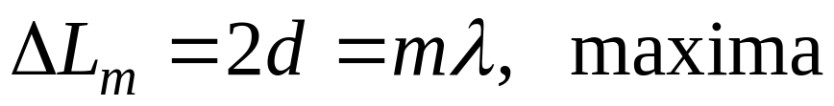



Michelson’s interferometer
Constant angle interference:
Originally built in 1881 for proving if the ether, the medium the light propagates with respect to, exists.

Slide 29

Michelson’s interferometer and light propagation
Demonstration!

Slide 30

Example:Yellow light (wave length = 589 nm) illuminates a Mechelson’s interferometer. How many bright fringes will be counted as the mirror is moved through 1.0 cm?

Slide 31




2. The thickness is not the same at different point (等厚干涉)

Slide 32





Discussion

Slide 33







The Newton’s ring:

Slide 34


Did you know?
You should never get immersion oil on microscope lenses that are not designed for it!
The oil is a thin film that can create light and dark spots all over your image!
(and it’s really hard to clean off, too!)

Slide 35
Homework:
Exercises
3
15
25
38
Problems
4
7

